Slide 1
AI projects
Project 1: Search algorithms (25 points).
Question 1,2,3 and 4 are mandatory (12 points).
Question 5,6,7 and 8 are optional (13 points).
Project 2: Multi-Agent search (25 points).
Question 1,2,3 and 4 are mandatory (19 points).
Question 5,6 and 7 are optional (6 points).
Project 1+ Project 2 > 45 points (+ 1 grade in the exam )

Slide 2
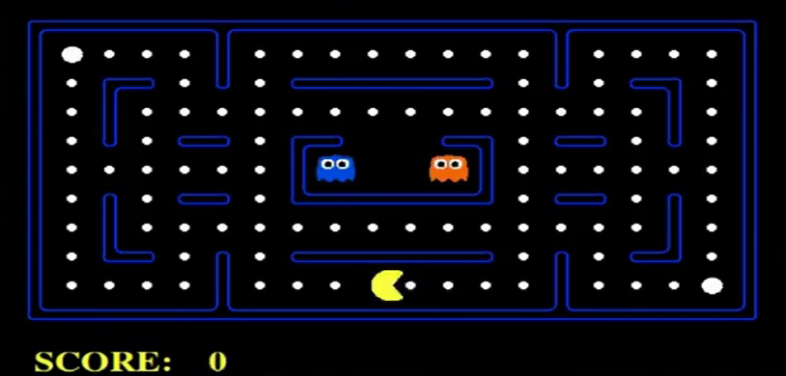
Pacman Game

Slide 3

Project 1: Search in Pacman

Slide 4
Project 1: Search in Pacman (Q1,2,3 and 4)
Depth First Search (Question 1)
Breadth First Search (Question 2).
Uniform Cost search (Question 3)
A* search (Question 4)

Slide 5



Search problem
Any search problem is defined :
A state representation (e.x., [pacman position, food positions, ghosts positions])
A successor function (with actions, costs)
A goal test
A solution is a sequence of actions ( directions) which transforms the start state to a goal state
“N”, 1.0
“E”, 1.0

Slide 6
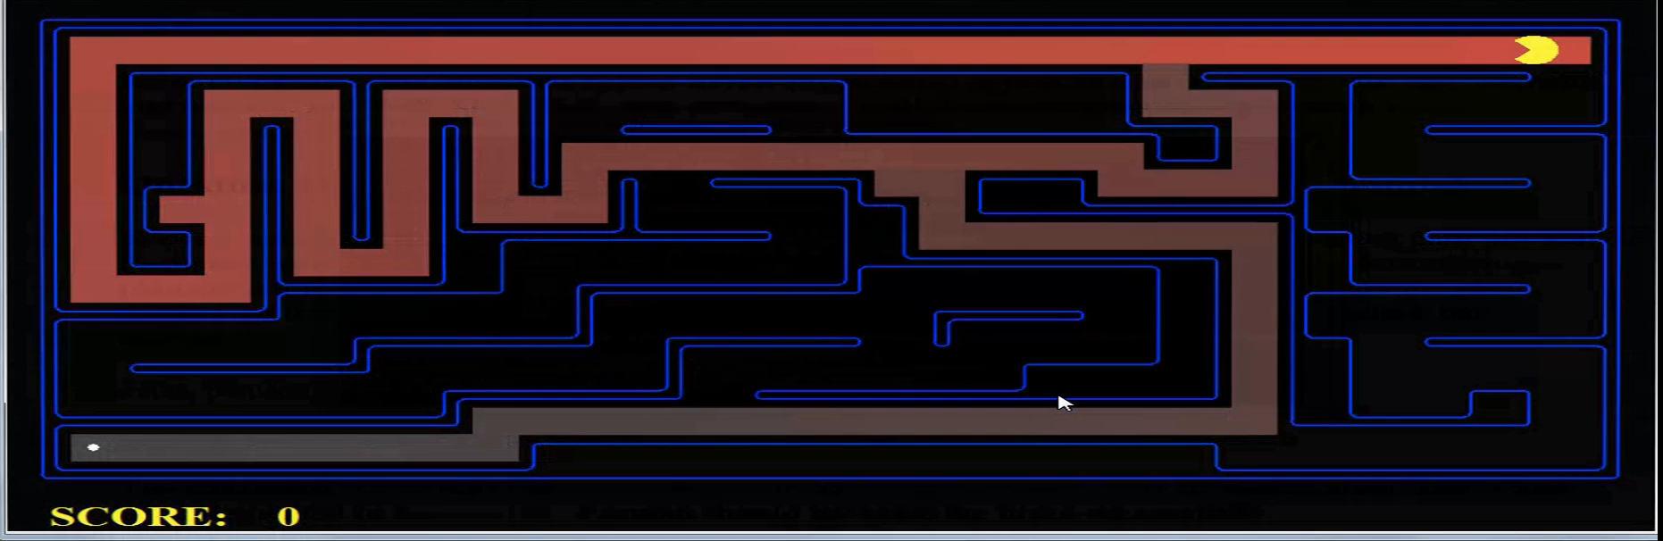
Project 1: Search in Pacman (Q1,2,3 and 4)

Slide 7
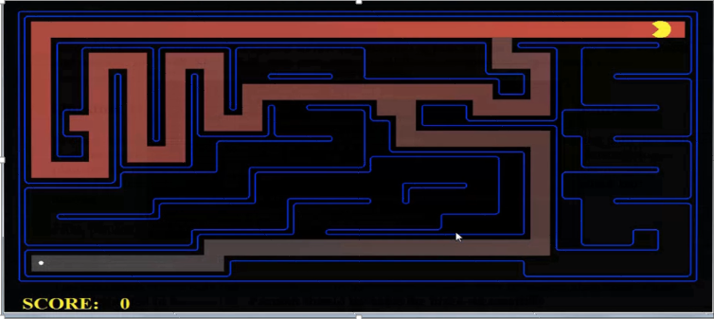
Project 1: Search in Pacman (Q1,2,3 and 4)
Problem: Pathing
States: (x,y) location
Successor: update the location of pacman
Goal test: is (x,y)==food position

Slide 8
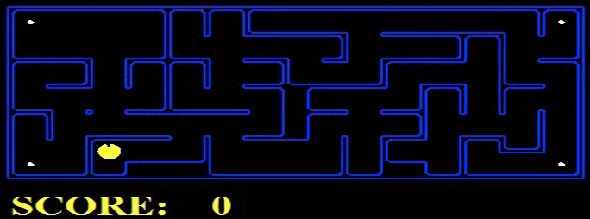
Project 1: Search in Pacman (Q 5 and 6)

Slide 9
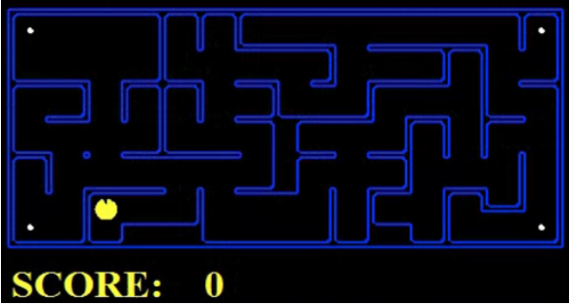
Project 1: Search in Pacman (Q 5 and 6)
Problem: Finding All the Corners
States: {(x,y), corners booleans}
Successor: update location and possibly a corner boolean
Goal test: all corners are true

Slide 10

Project 1: Search in Pacman (Q 7 and 8)

Slide 11
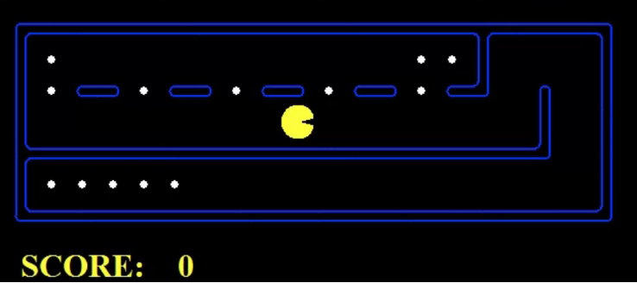
Project 1: Search in Pacman (Q 7 and 8)
Problem: Eating All The Dots
States: {(x,y), dots booleans}
Successor: update location and possibly a dot boolean
Goal test: all dots are true

Slide 12
Project 1: Search in Pacman (Background)
Python basics programming (python 2.7).
- Installation:
https://www.python.org/downloads/
- Tutorials:
http://www.python-course.eu
https://docs.python.org/3/tutorial/
https://www.tutorialspoint.com/python/
Have an idea about the different search algorithms (read the course material)

Slide 13
Project 1: Search in Pacman (code)
Files you'll edit:
search.py: Where all of your search algorithms will reside.
searchAgents.py: Where all of your search-based agents will reside.
(sucesor, goal function).
Files you might want to look at:
pacman.py: The main file that runs Pacman games. This file describes a Pacman GameState type, which you use in this project.
game.py: The logic behind how the Pacman world works. This file describes several supporting types like AgentState, Agent, Direction, and Grid.
util.py : Useful data structures for implementing search algorithms.

Slide 14
Project 1: Useful function
start=problem.getStartState() : get the starting position.
succ=problem.getSuccessors(state) : get successors of state state.
stack=util.Stack(): Define a Stack structure stack.
queue=util.Queue(): Define a Queue queue.
Pqueue=util.PriorityQueue (): Define a PriorityQueue Pqueue.
util.Stack.push(stack, state))/ util.Queue.push(queue, state)): push the state state into the Stack (satck) or Queue (queue)
state=util.Stack.pop(stack): pop the last element from a stack stack
state=util.Queue.pop(queue): pop the last element from the Queue queue.
problem.isGoalState(state)): check if the state state is a final state

Slide 15
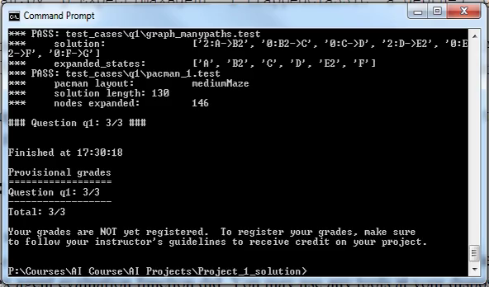
Project 1: Search in Pacman (code)
Check your implementation by running the autograder function

Slide 16
Conclusions
Write a short report explaining your implementation .
Send your report and your code to Zinelabidine.Boulkenafet@oulu.fi before 09/02/2018.
Try to start early and ask questions if you have any problems.
The projects can be done individually or in a team of 2 or 3 students.

